Slide 1
Rubber Duckies FTW
Astro Pryor and Grant Stautzenberger

Slide 2
Who are we?
We are Rubber Duckies FTW.
We are your one stop shop for buy and creating personalized rubber ducks for everything from your desk to your bath.

Slide 3
How it works
Our website creates a place for customers to come and get personalized rubber ducks to own. As programers many of us keep a rubber duck on our desk to read off our code to help us find where we need to tweak our creations.
Having a place to buy and create a customized rubber feathered desk companion allows you to have a little bit of your own personality sitting on your desk to liven up your day.
Our website acts as a medium to allow you to do just that. We have prebuilt ducks for sale. However we also have created a place where you can design your own duck.

Slide 4
How does she look?

Slide 5
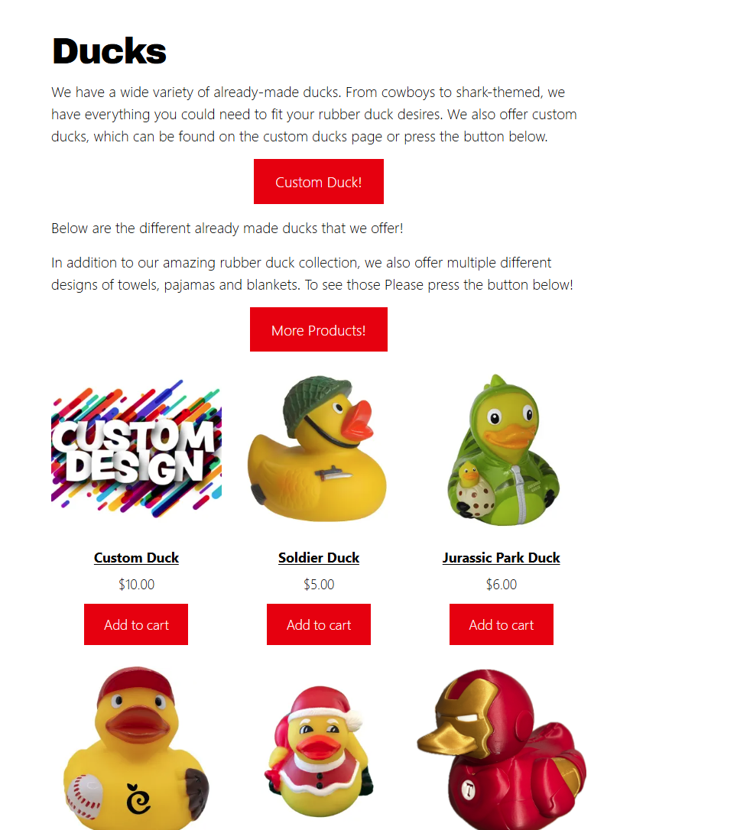
Ain’t she pretty?
We created a User friendly interface on our client side that is used for browsing our selection of rubber duck themed merchandise, personalising the merch and purchasing said merch.

Slide 6


Slide 7
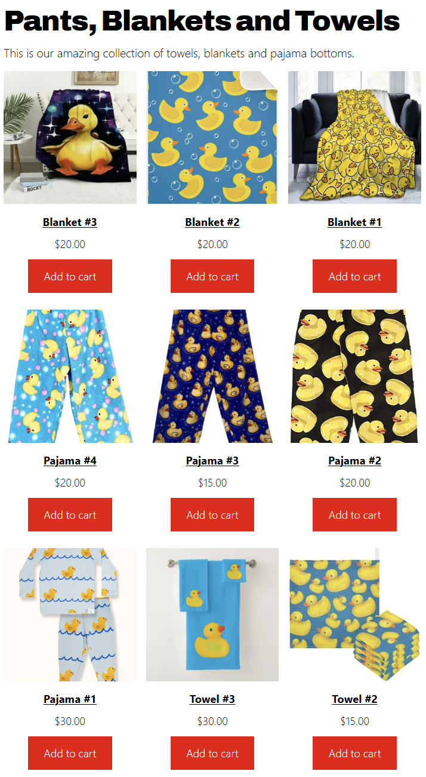

Slide 8
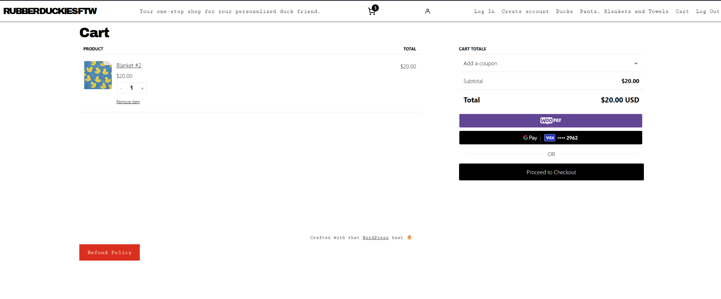

Slide 9
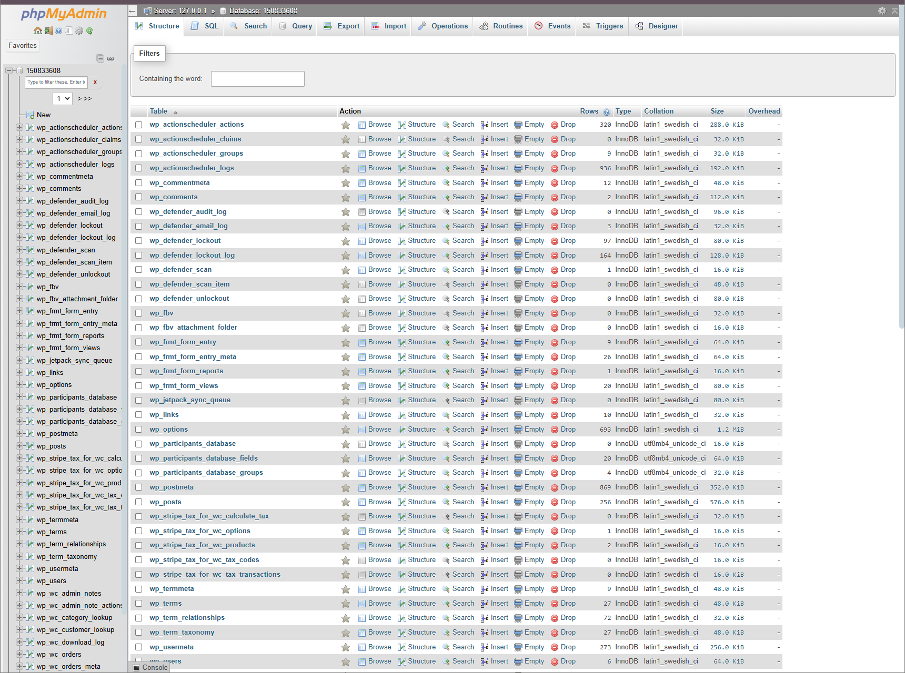
Inside and out!
Utilizing the features provided through Wordpress out back end server handles authentication, secure payment gateways and product management. These features include Wordpress’ hosting environment with PHP and MySQL backend.

Slide 10

Plus She’s Smart
We used WP2FA, Defender, WooCommerce and some editing plugins.
The data is stored in Wordpress databases systems using encrypted credentials and the products and stock management data is managed using WooCommerce.

Slide 11
Project Structure
We also used several plugins for authentication, the payment gateway and product listing.
We used WP2FA, Defender, WooCommerce and some editing plugins.
The data is stored in Wordpress databases systems using encrypted credentials and the products and stock management data is managed using WooCommerce.

Slide 12
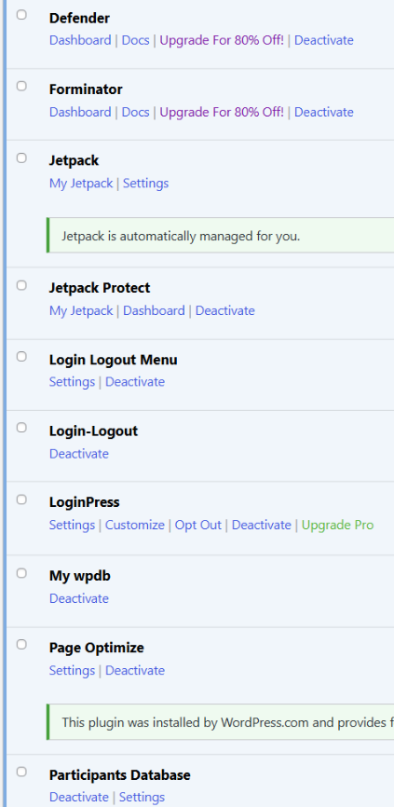
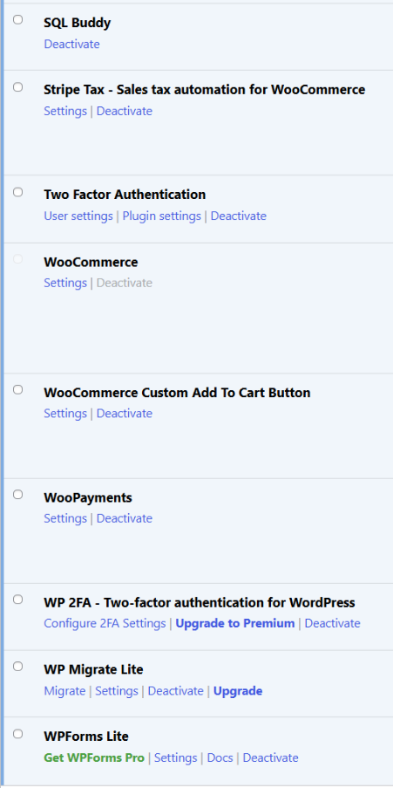

Slide 13
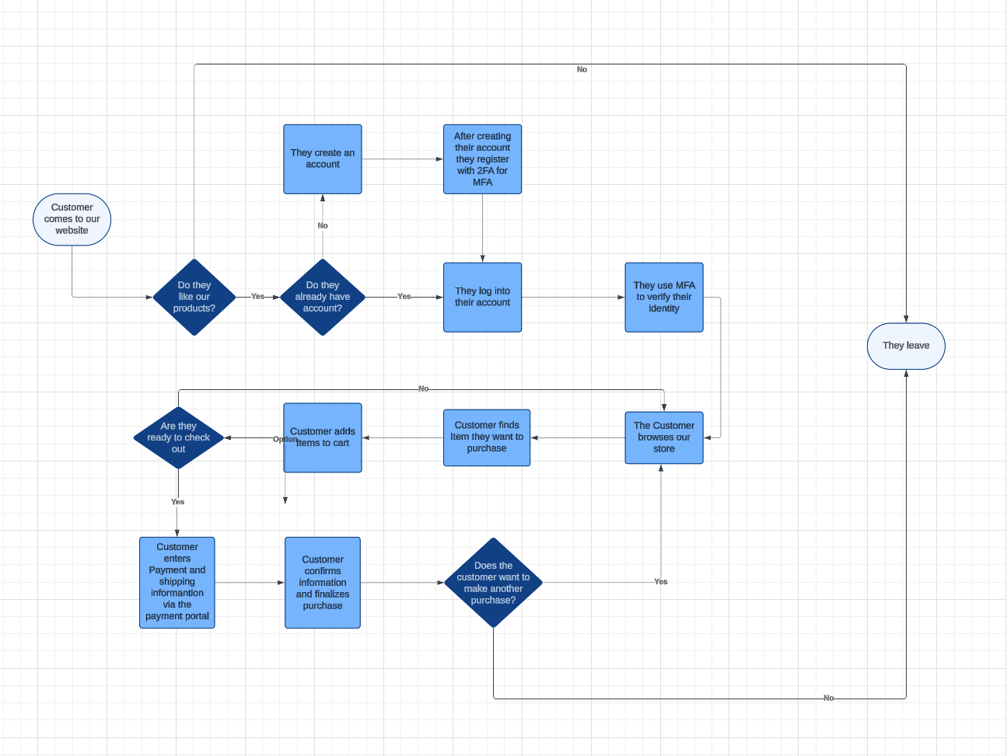
Data Flow

Slide 14
Results and Analysis
We have implemented a secure login and logout system that involves multi factor authentication.
We have installed a secure payment gateway to ensure the user’s information won’t get stolen.
The website is completely functioning.
For the vulnerability assessment we used Quallys, HostedScan, Security Headers and Nessus and there were minal security problems. All of them were low or medium severity risks.

Slide 15
Results and Analysis
Overall there were only 4 big vulnerabilities
Missing security headers
Content security policy, anti CSRF tokens, CORD misconfiguration
Insecure cookies
Missing HttpOnly, secure and SameSite attributes
Network vulnerabilities
Open TCp ports (80 and 443)
SSL/TLS configuration issues
HSTS preload not enabled

Slide 16
Results and Analysis
To remedy these vulnerabilities, we would need to make these changes
Implement a CSP header to restrict content sources
Add anti-CSRF tokens to submission forms for secure submissions
Update the CORS policy to allow only trusted domains
Add HttpOnly, Secure and SameSite attributes to all cookies
Disable ICMP timestamp replies or block it via firewall
Submit the domain for HSTS preloading for better and enhanced HTTPS enforcement

Slide 17
Results and Analysis
We faced a lot of different challenged during this project. These include
Setting up multi factor authentication
Verifying authentication
Restarting from scratch because our first website couldn’t implement all the features that we wanted
Not knowing the proper plugins to add to the website to get the features we needed
We overcame these challenges by
Creating a new website weeks before the due date
Spent a good amount of time researching and testing different 2 factor authentication tools
Implementing the different plugins that we found and testing them

Slide 18
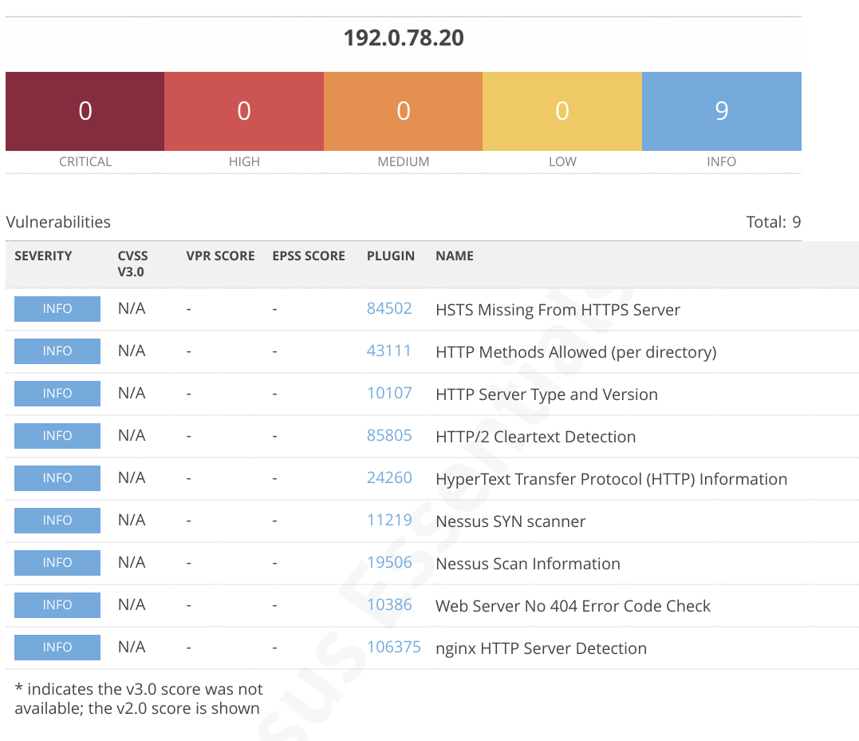

Slide 19
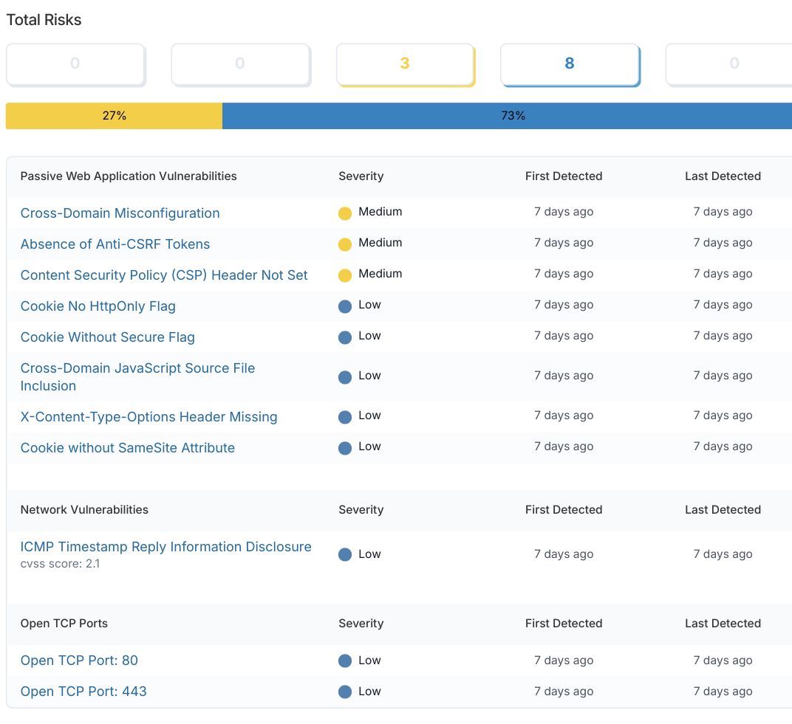

Slide 20
Conclusion
In the end, we creates a secure and user friendly ecommerce platform using wordpress. We implemented several safety features without coding them thanks to Wordpresses plugins.
Overall, we gained proficiency in using wordpress and how websites function on the front and backend. Selecting the correct plugin and doing research on the ones that we did add was essential and enhanced our skills for website vulnerability testing and optimizing Wordpress for the best performance.

Slide 21
Video of Website

Slide 22
